Slide 1
Are neural networks all you need?
Lennard Berger

Slide 2
Audience
This talk is for you:
if you have some knowledge of word2vec and / or embeddings
you’ve always wondered why neural networks perform so well (what is their “secret sauce”)

Slide 3
A recap on neural networks
Neural networks are useful as universal function approximators. They can solve non-trivial (non-linear) problems, that simple models cannot solve.

Slide 4
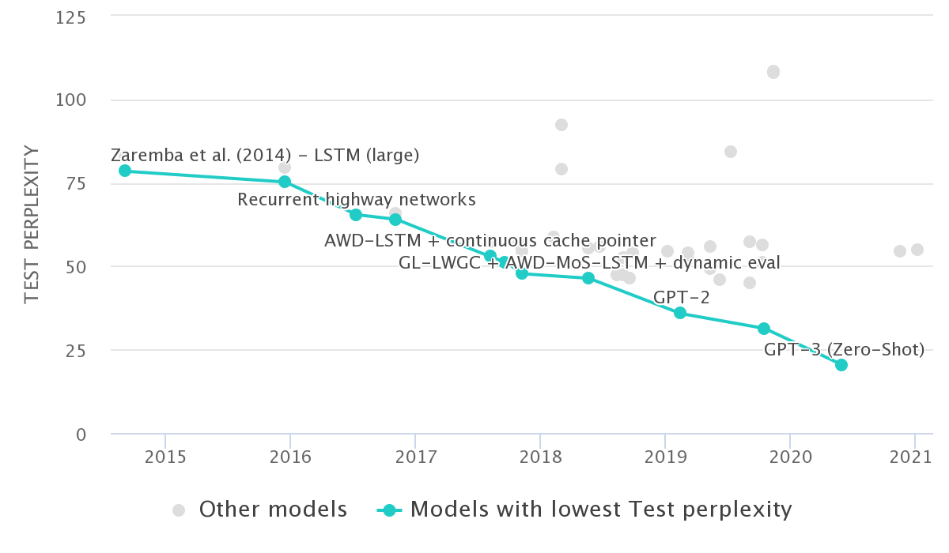
Neural networks are state of the art (SotA)
Language Modelling on Penn Treebank (Word Level)

Slide 5
No free lunch
In a noise-free scenario where the loss function is the misclassification rate, if one is interested in off-training-set error, then there are no a priori distinctions between learning algorithms (Wolpert 1996)

Slide 6
When GZIP beats neural networks
This year (Jiang et al. 2023) published a paper in which simple models based on compression algorithms were able to outcompete SotA models. The model builds on the intuition that compressors will remove redundant information between two sentences.

Slide 7
Compression based classifiers
The parameter-free model introduced by (Jiang et al. 2023) calculates the normalised compressed distance (NCD), and can be used as follows:
Let $C$ be the compressor (e.g GZIP)
Calculate the compressed text length for $x_{1},x_{2}$
$NCD\left(x,y\right)=\frac{C\left(xy\right)−minC\left(x\right),C\left(y\right)}{maxC\left(x\right),C\left(y\right)}$
Feed the NCD into your favourite classifier, such as KNN

Slide 8
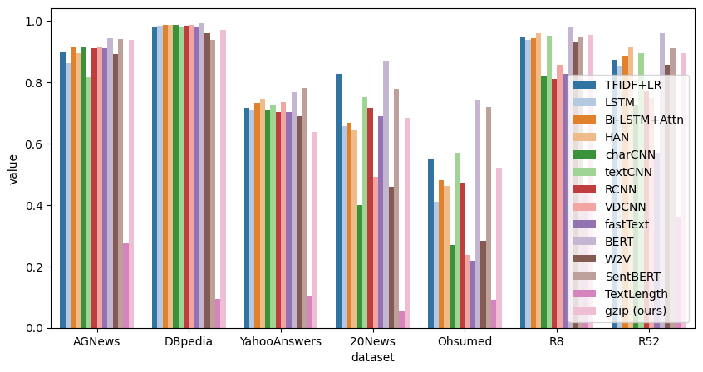
Evaluation
Figure 1: Accuracy of different models on news classification tasks

Slide 9
Rigid benchmarks
It is important to note that (Jiang et al. 2023) evaluate on a narrow task set. Their method is used exclusively for classification, whereas other models are applied to a broad range of tasks (clustering, retrieval, semantic similarity etc). While they achieve a new (or comparable) SoTa, the comparison is not entirely fair. Further their evaluations are mono-lingual!

Slide 10
A look into word2vec
(Levy, Goldberg, and Dagan 2015) took a look into the companion code of word2vec and GloVe, and found that there was no distinct advantage in using neural networks.

Slide 11
Algorithms examined
Positive pointwise mutual information (PPMI)
Singular value decomposition (SVD)
Skip-grams with negative sampling (SGNS)
Global Vectors (GloVe)

Slide 12
Transferable hyperparameters
(Levy, Goldberg, and Dagan 2015) introduce several distinct hyperparameters that are used by word2vec and GloVe to enable (or improve) the training objective. They split these hyperparameters into three groups:
pre-processing hyperparameters
associative metric hyperparameters
post-processing hyperparameters

Slide 13
Pre-processing hyperparameters
dynamic context windows (dyn)
In traditional BOW windows (PMI), all words are weighted equally. In word2vec and GloVe, only words that are withing a given window (e.g 5 tokens) will be considered. In word2vec the weight per token is given by uniformly sampling the actual window size between 1 and L, for each token (Mikolov et al. 2013).
subsampling (sub)
Subsampling is a method of diluting very frequent words, akin to removing stop-words. The subsampling method presented in (Mikolov et al. 2013) randomly removes words that are more frequent than some threshold t with a probability of p, where f marks the word’s corpus frequency:
$p=1−\sqrt{\frac{t}{f}}$

Slide 14
Pre-processing hyperparameters
deleting rare words (del)
word2vec removes tokens that are rare in the training corpus from the corpus before creating context windows.

Slide 15
Association Metric hyperparameters
Shifted PMI (neg)
SGNS has a hyperparameter k (the number of negative samples), which affects the value that SGNS is trying to optimize $∀w,c$. This hyperparameter changes the underlying distribution of the model by making different tokens more (or less) probable.
Context distribution smoothing (cds)
In word2vec, negative examples (contexts) are sampled according to a smoothed unigram distribution. Similarly to shifted PMI, this helps alleviating bias against rare words.

Slide 16
Post-processing hyperparameters
Adding context vectors (w+c)
(Pennington, Socher, and Manning 2014) propose using the context vectors in addition to the word vectors as GloVe’s output. For example, the word “cat” can be represented as:
$\vec{V_{cat}}=\vec{w_{cat}}+\vec{c_{cat}}$
where $\vec{w_{cat}}$ and $\vec{c_{cat}}$ are the word and context embeddings, respectively. The aim of this method is to move together words that are semantically similar (share the same context).
Eigenvalue Weighting (eig)
The decomposition of the eigenvalue (for SVD) doesn’t need to decompose uniformly. The factorisation can be a tuneable hyperparameter.

Slide 17
Evaluation
We introduced seven hyperparameters which are implicitly (or explicitly) tuned for in word2vec and GloVe. In their evaluation (Levy, Goldberg, and Dagan 2015) systematically applied these hyperparameters using hyperparameter tuning for the different available algorithms.

Slide 18
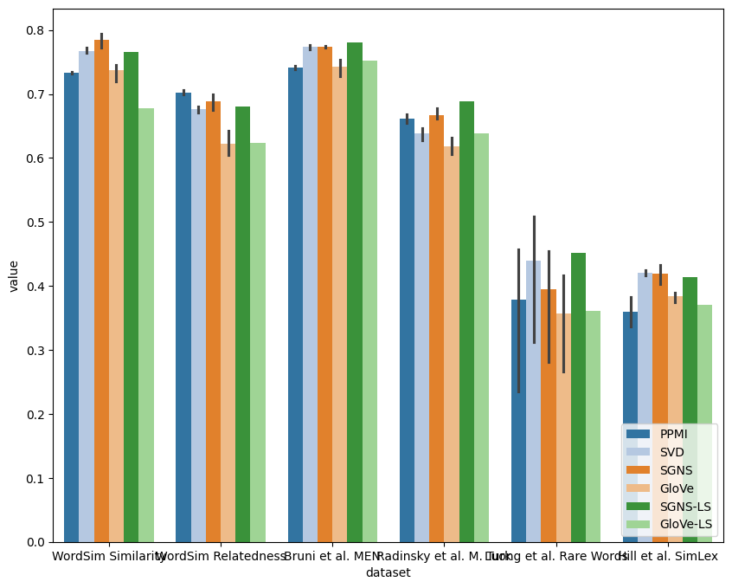
Results
Figure 2: Performance of each method across different tasks using 2-fold cross-validation for hyperparameter tuning

Slide 19
Conclusions
there is no one preferable method to produce word embeddings (there is no free lunch!)
we don’t know what exactly neural networks contribute to this task
evaluations need to be rigid and contain hyperparameters

Slide 20
Closing remarks
To train word2vec five hyperparameters were introduced which were not considered part of the evaluation. In a lot of machine learning publications, tuneable hyperparameters are simply given as part of the training objective! We need to have solid baselines to see what neural networks actually achieve.

Slide 21
References
Jiang, Zhiying, Matthew Yang, Mikhail Tsirlin, Raphael Tang, Yiqin Dai, and Jimmy Lin. 2023. “‘Low-Resource’ Text Classification: A Parameter-Free Classification Method with Compressors.” In Findings of the Association for Computational Linguistics: ACL 2023, 6810–28.
Levy, Omer, Yoav Goldberg, and Ido Dagan. 2015. “Improving Distributional Similarity with Lessons Learned from Word Embeddings.” Transactions of the Association for Computational Linguistics 3: 211–25. https://doi.org/10.1162/tacl_a_00134.
Mikolov, Tomas, Kai Chen, Greg Corrado, and Jeffrey Dean. 2013. “Efficient Estimation of Word Representations in Vector Space.” https://arxiv.org/abs/1301.3781.
Pennington, Jeffrey, Richard Socher, and Christopher Manning. 2014. “GloVe: Global Vectors for Word Representation.” In Proceedings of the 2014 Conference on Empirical Methods in Natural Language Processing (EMNLP), 1532–43. Doha, Qatar: Association for Computational Linguistics. https://doi.org/10.3115/v1/D14-1162.
Wolpert, David H. 1996. “The Lack of A Priori Distinctions Between Learning Algorithms.” Neural Computation 8 (7): 1341–90. https://doi.org/10.1162/neco.1996.8.7.1341.

